Slide 1
Django in the real world
Susan Ibach
Christopher Harrison

Slide 2
Content administration

Slide 3
The scenario
Lots of little pieces of data
Tracks
Dietary restrictions
Conference rooms
Session slots
Sponsors
All of this needs to be updated by the staff
I don't want to build forms for each one of those

Slide 4
The solution
Django admin site
Built in data administration
Automatic form creation
All we need to do is register our classes
Automatically configured with default project from django-admin
Available from /admin

Slide 5
Admin site security
Staff
Manage data
Superuser
Manage data and users
Create users using django-admin or manage.py

Slide 6
Creating superusers

Slide 7
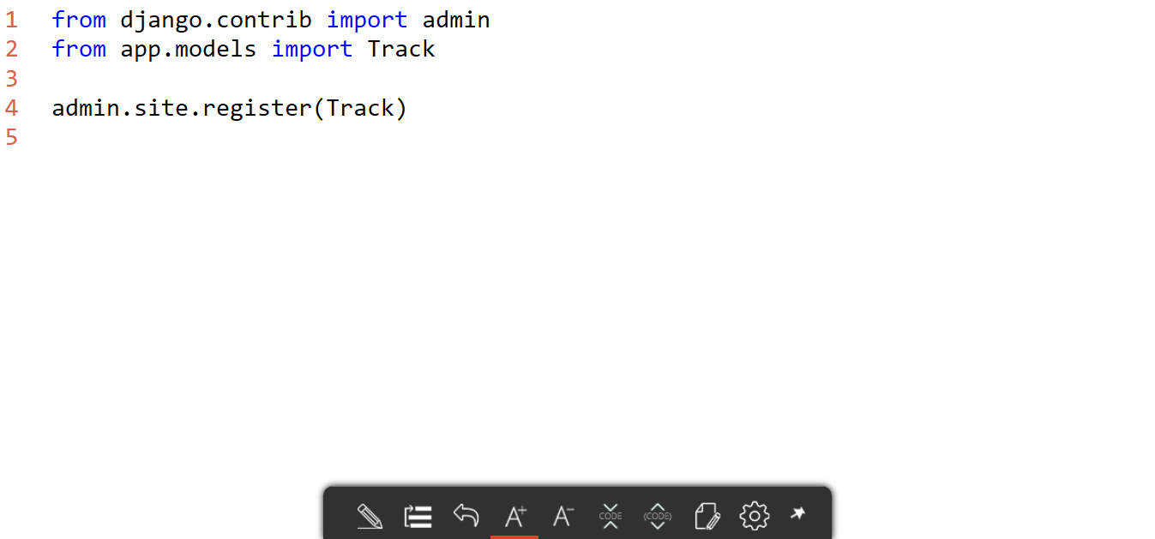
Model registration

Slide 8
Registering models

Slide 9
Default list display

Slide 10
You may have noticed the list leaves a little to be desired
Only provides the name of the class
Wouldn't it be nice if we could control what's displayed?

Slide 11
List display
Simplest way to control the list display is to override __str__
Introduced with Python 3
Default string conversion
class Track(models.Model):
title = models.CharField(max_length=50);
description = models.TextField(max_length=1000);
def __str__(self):
return self.title;

Slide 12
Overriding __str__

Slide 13
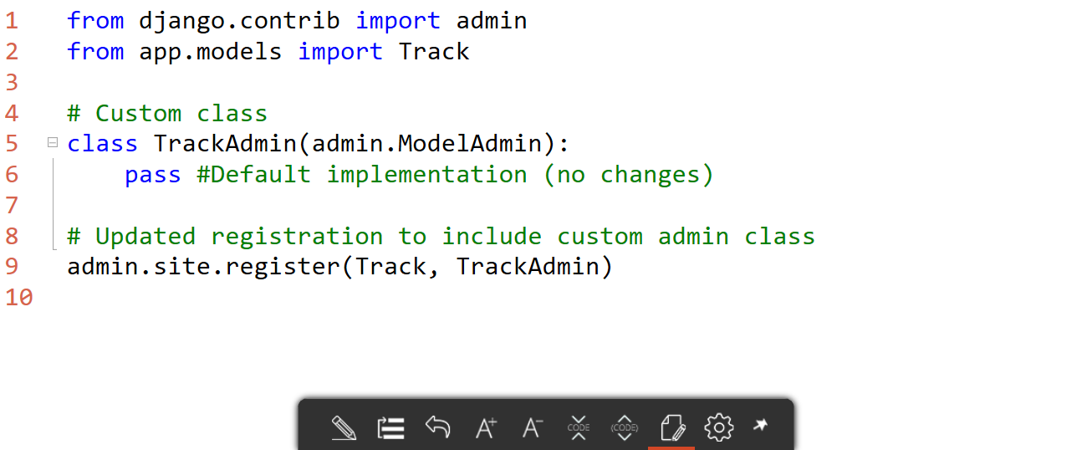
Admin form class

Slide 14
Multiple list fields
Use list_display to choose what fields to display
list_display = ("name","bio",); #Must be a list

Slide 15
Choosing list fields

Slide 16
List filtering

Slide 17
Enabling search
When you have a lot if items, it can be a challenge to find the ones you want
Django admin allows you to easily implement search
search_fields = ['title', 'abstract'];

Slide 18
Implementing search

Slide 19
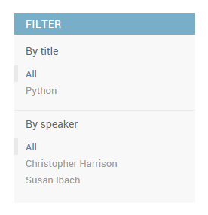
Enabling filtering
If you have natural groups of objects, you can enable filtering
Can even use __ (double underscore) to navigate into related objects
list_filter = ('track__title', 'speaker',);

Slide 20
Enabling filters

Slide 21
Customizing forms

Slide 22
Let's say we updated the speaker class...
And we added social media information
The problem?
Not everyone uses social media
As our class gets larger, the form can become more complex

Slide 23
Fortunately we can customize the form
Fields controls the order and grouping of fields
Fieldsets allows us to create groups

Slide 24
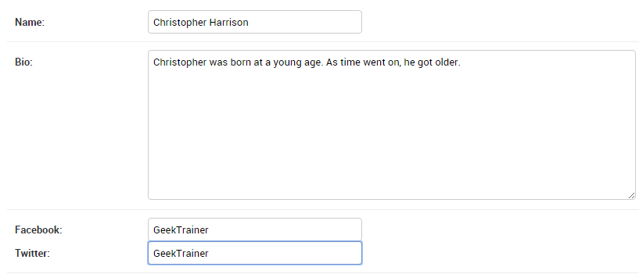
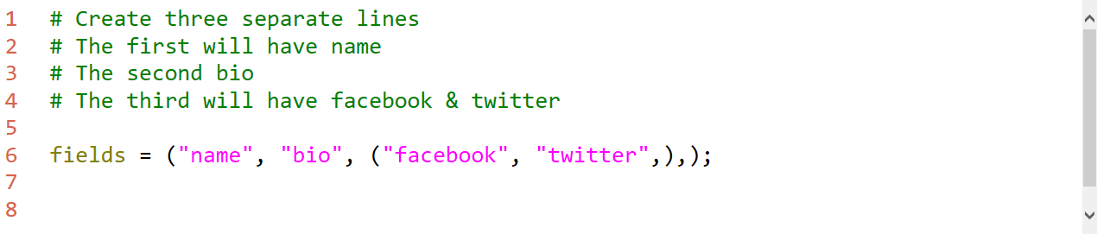
Fields

Slide 25
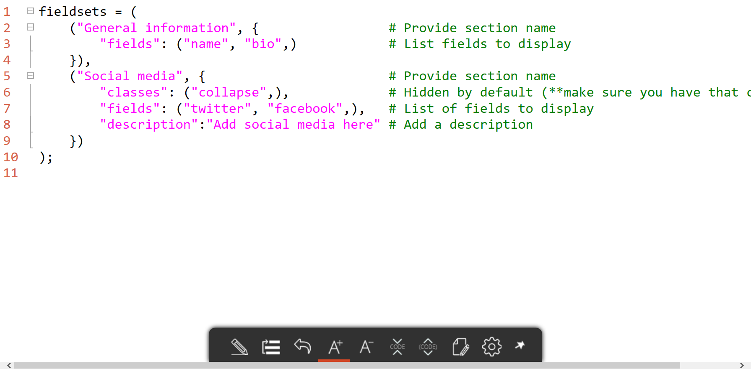
Fieldsets

Slide 26
Basic options
Date hierarchy (date_hierarchy)
Change the display to date-based drilldown
Hide fields (exclude)
Remove fields from admin page
Empty data (empty_value_display)
What to display for a blank field

Slide 27
Controlling admin form fields

Slide 28
Custom actions

Slide 29
What if I don't want to update one item at a time?
For example, how about
Approving a bunch of sessions?
Rejecting a bunch of sessions?
By default, Django admin provides a delete action
We can add our own custom actions

Slide 30
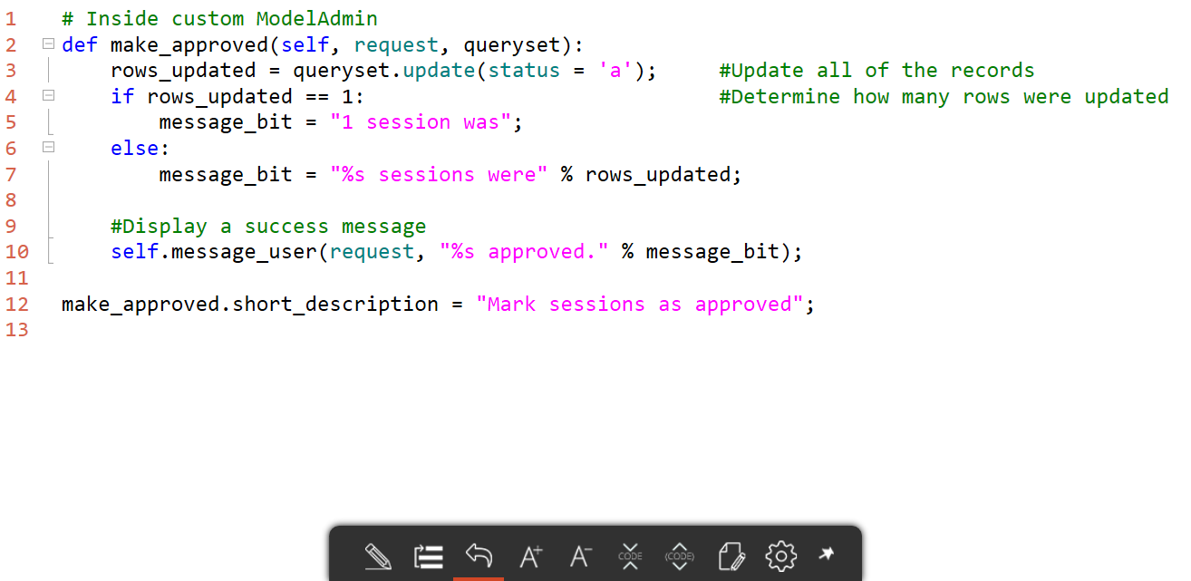
Custom actions

Slide 31
Custom actions

